Slide 1
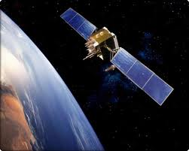
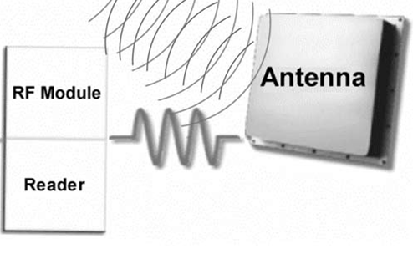

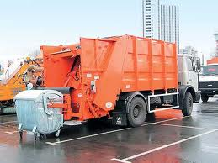
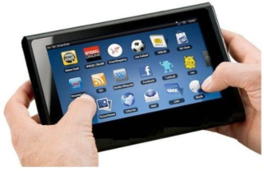

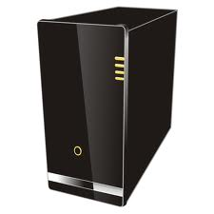
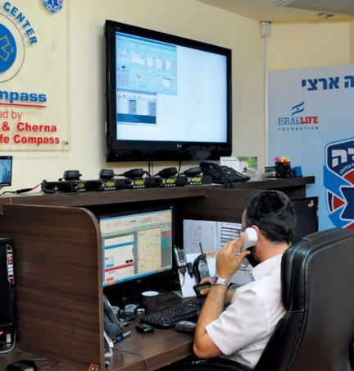

SCADA- system of cleaning of garbage containers
RFID-Sensor - Bluetooth
GPS
Mobile Administration
WEB-Portal-Server
3G Mobile
Cloud services
Internet
Dispatcher
Notes:
The second project was successfully implemented in Chisinau city on Autosalubritate company
<number>

Slide 2
SCADA- system of cleaning of garbage containers
Mobile Interface 1
Notes:
Login
<number>

Slide 3
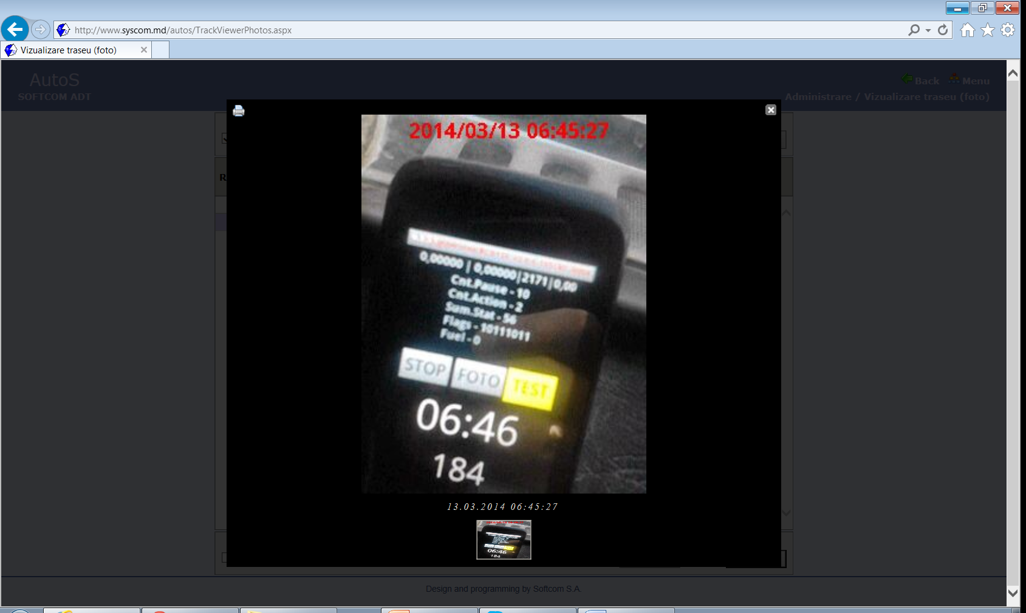
SCADA- system of cleaning of garbage containers
Mobile Interface 2
Notes:
Smartphone in cabin of vehicle. Operating mode.
<number>

Slide 4
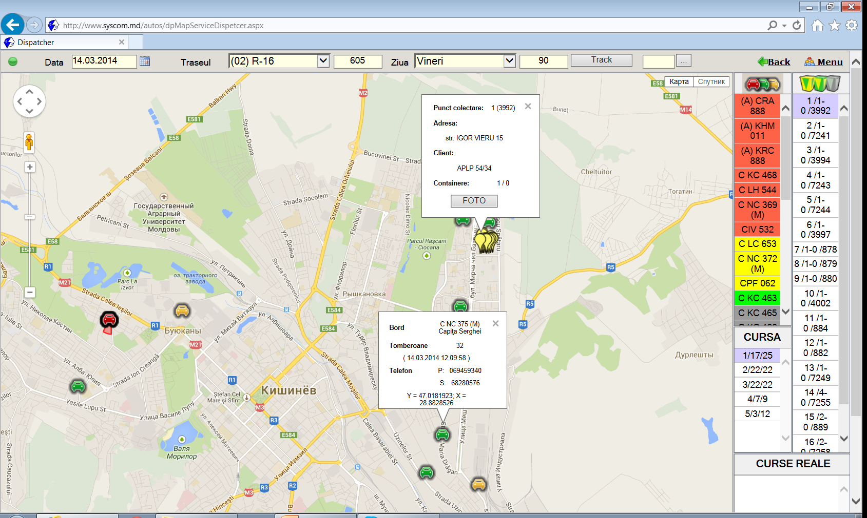
SCADA- system of cleaning of garbage containers
Dispatcher’s interface 1
Notes:
Here we see the cars and customers.
<number>

Slide 5
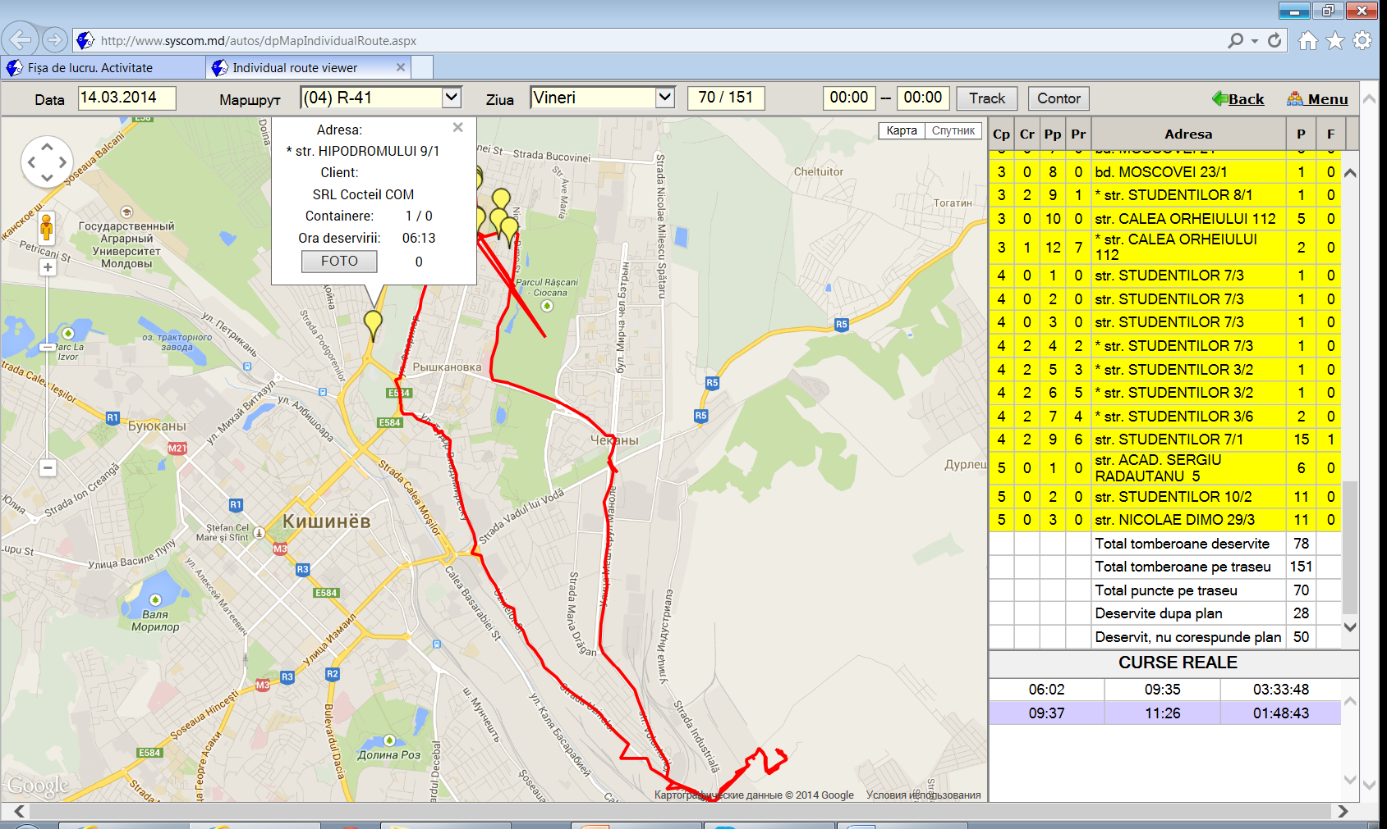
SCADA- system of cleaning of garbage containers
Dispatcher’s interface 2
Notes:
Here we see points of collection of garbage containers and track of vehicle
<number>

Slide 6
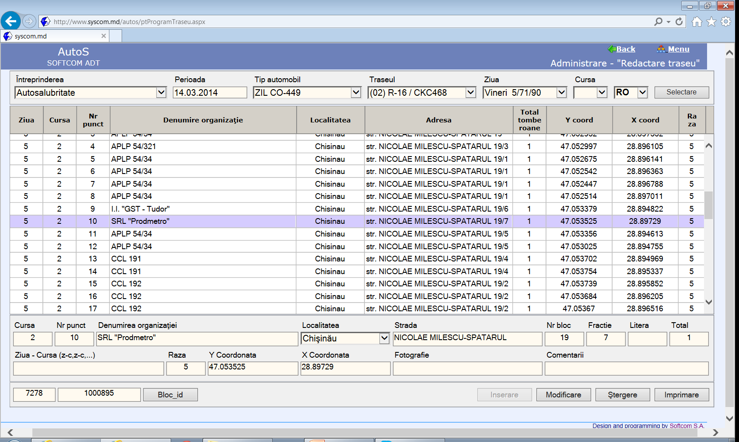
SCADA- system of cleaning of garbage containers
Database
Notes:
Here we see Database of clients (companies).
<number>

Slide 7
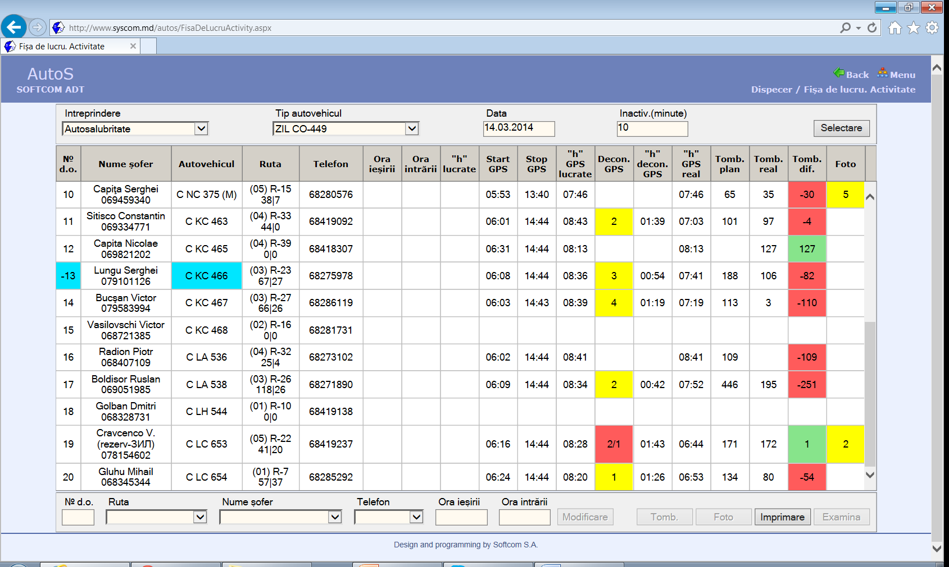
SCADA- system of cleaning of garbage containers
Report 1
Notes:
Here we see one of reports for vehicles
<number>

Slide 8
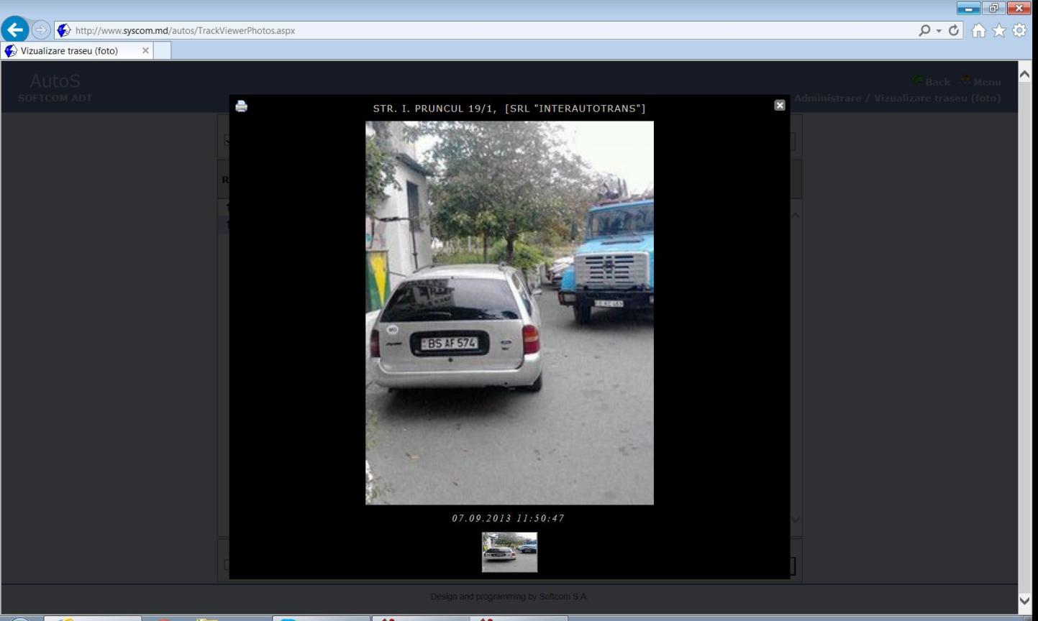
SCADA- system of cleaning of garbage containers
Report 2
Notes:
Here we see the picture report of vehicle driver about impossibility of cleaning of the garbage containers because car prevent. Client shall provide access. The work is executing on base of contract.
<number>

Slide 9
SCADA- system of cleaning of garbage containers
Advantages
In the exploitation period of ITS was increased the quality of clients services,
was automated routine work (reports) ,
was disciplined the work of drivers and administrative staff.

Slide 10
END
Thank your for your attention!
Any questions?

